Slide 1
Regression Analysis - Phase 2 Project

Slide 2
Content
Business Problem
Data Understanding
Data Preparation
Regression Analysis
Conclusions

Slide 3
Business problem
Real estate is considered real property that includes land and anything permanently attached to it or built on it, whether natural or man-made. These include residential, commercial, industrial, raw land, and special use.
Investing in real estate includes purchasing a home, rental property, or land. Indirect investment in real estate can be made via Real Estate Investment Trusts or through pooled real estate investment.
A real estate agency helps homeowners buy and/or sell homes. The stakeholder is in the need to provide advice to homeowners about how home renovations might increase the estimated value of their homes, and by what amount.

Slide 4
Data preparation
The steps taken to prepare the data for analysis and modelling were:
Dropping the columns that are redundant and not required for the analysis.
Duplicate identification and drop them.
Checking for invalid entries and imputing
Checking for and imputing null values.
Categorical variables conversion to individual columns.
Scaling of the continuous variables.
Dealing with multicollinearity.

Slide 5
Regression Analysis

Slide 6
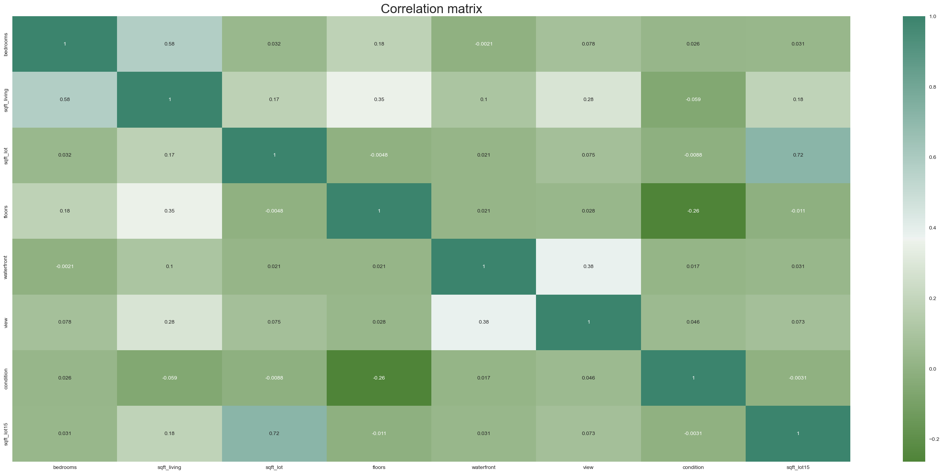
Correlation matrix

Slide 7
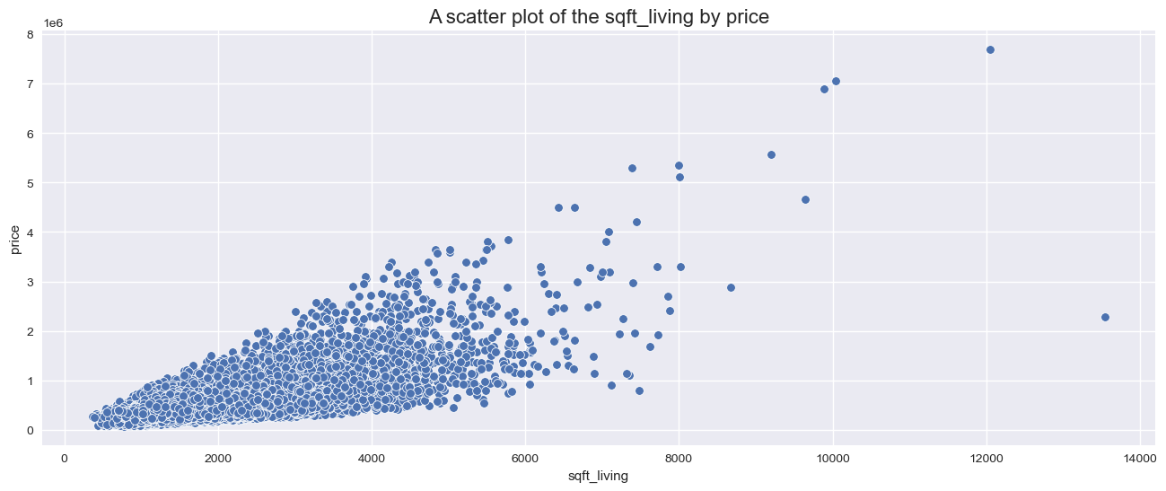
Scatterplot of the best predictor with the price
There is a positive linear relationship between the square feet of living (footage of the home) with pricing. An increase in one causes a unit increase in the other.

Slide 8
Simple Linear Regression Analysis

Slide 9
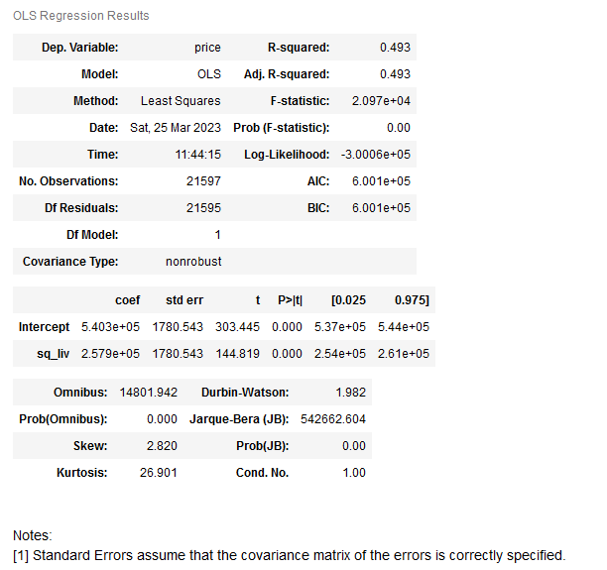
Regression Analysis Output
The model is able to explain 49.3% variation of the data.
The intercept is approximately 257900.
The model p_values is less than 0.001 meaning that there is a correlation between the dependent and independent variables used in the model (price and footage of the home).

Slide 10
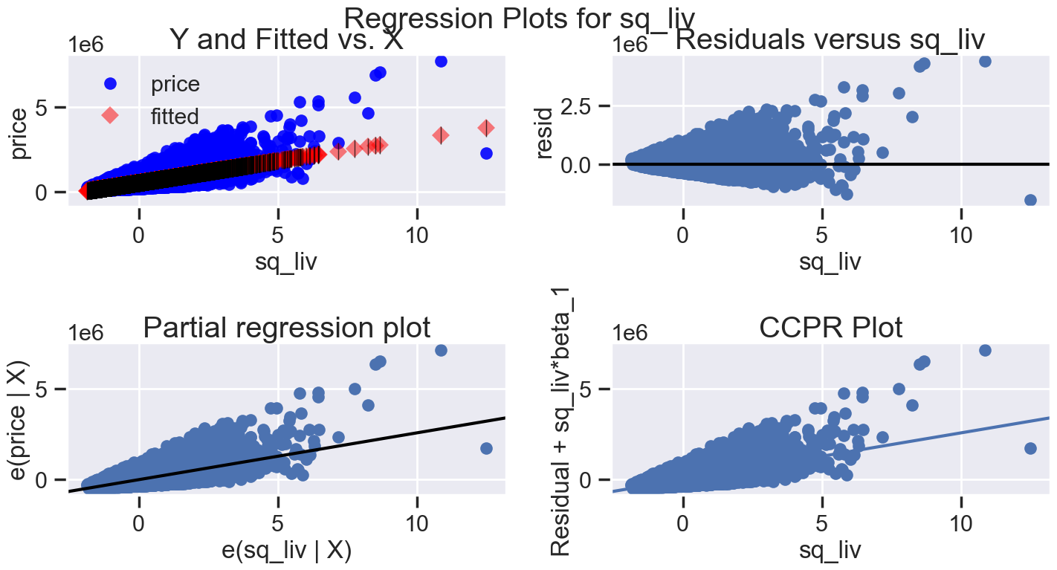
Regression plots
The Y and Fitted vs. X graph plots show a positive relationship showing the price and square feet of living area.
The Residuals versus sqft_living graph shows the model errors versus the predictor variable.
The Partial regression plot shows the relationship between price and square feet of living.

Slide 11
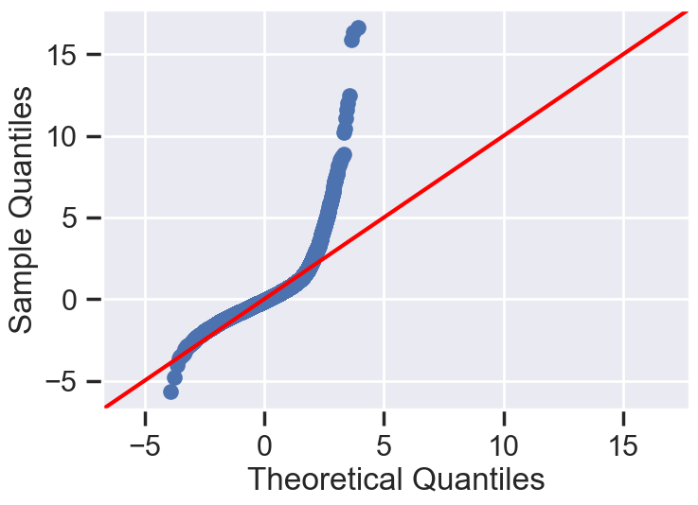
Normality plots
From the normality plot above, we can conclude that the data is not normally distributed

Slide 12
Multiple Regression Analysis

Slide 13
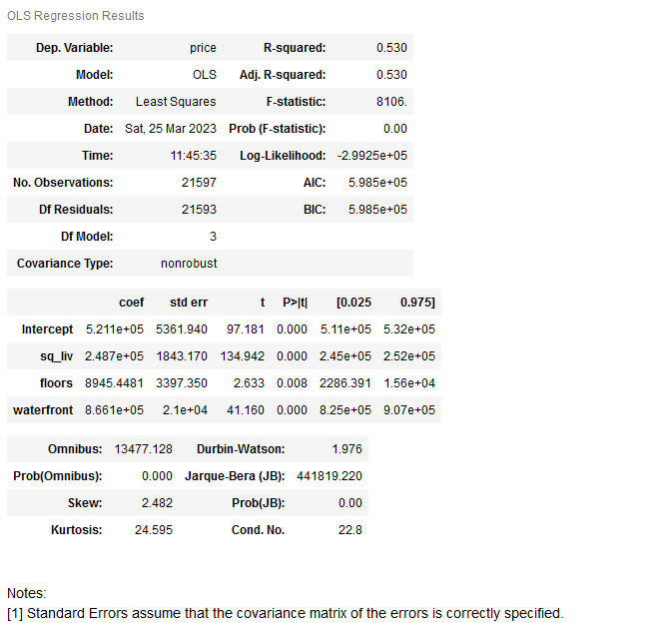
Regression Analysis Output: 3 predictors only
The model has an R-squared value of 53.0% variation of the data.
The model p_values is less than 0.001 meaning that there is a correlation between the predictors and outcome variable used in the model.

Slide 14
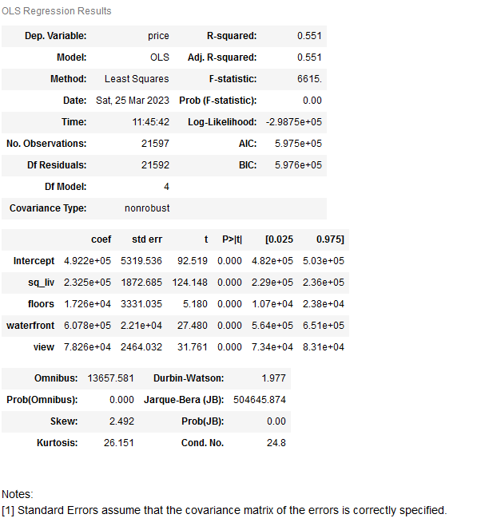
Regression Analysis Output: 4 predictors only
The model has an improved R-squared value of 55.1% variation of the data from the previous 53.0%.
The model p_values is less than 0.001 meaning that there is a correlation between the predictors and outcome variable used in the model.
Increasing or adding more variables has significant value to the model.

Slide 15
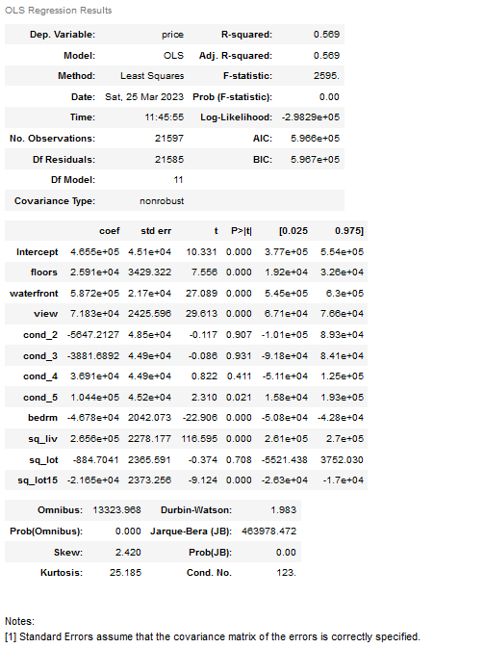
Regression Analysis Output: All predictors variables
The model has a more improved R-squared value of 56.9% variation of the data from the previous 55.1%.
The model pvalues are less than 0.001 meaning that there is a correlation between the predictors and outcome variable used in the model.
Increasing or adding more variables has significant value to the model.
Looking at the individual pvalues of the predictors, we have few predictors where pvalues are greater than alpha 0.05 meaning they do not have an impact on the outcome variable.

Slide 16
Conclusions

Slide 17
Conclusion
From the analysis, it was noted that square feet of living have a strong positive correlation with the house pricing

